Slide 1
HMT 801 Travel Agency and Tour Operations
UNIT 5
Travel Bodies and Association
Topic
History, aims and role of WTTC
Course Outcome (CO)
CO5: Evaluate the Sustainability of Travel operations and activities of travel bodies and associations

Slide 2
Why was WTTC formed?
In the late 1980s a group of industry Chairs and CEOs, led by James Robinson III - then Chairman and CEO of American Express - came to the realisation that, although Travel & Tourism was the largest industry in the world and the biggest provider of jobs, few in the industry, let alone within governments, were aware of this. There was no consolidated data, nor industry voice, through which to convey this message to elected officials and policy-makers. Indeed, Travel & Tourism was considered by many as frivolous or, at least, a 'non-essential' activity.

Slide 3
Why was WTTC formed?
This realisation led to an initial meeting in Paris in 1989 between a number of industry leaders from different parts of the globe. One notable outcome of the meeting was that the participants received a powerful message from Henry Kissinger, which confirmed that they represented the world’s biggest industry but that it was not recognised because it was too fragmented. This gave added impetus to the group’s objectives and WTTC was established in 1990, with James Robinson III as Chairman and Geoffrey Lipman as President. At the time of the first AGM in Washington in 1991, in the aftermath of the Gulf War, the Council comprised 32 Members. This first official meeting served to determine the objectives of WTTC and the key issues to be addressed.

Slide 4
Why was it formed
The three main messages are in keeping with the vision of the CEOs who founded the Council in 1990:
Governments recognising Travel & Tourism as a top priority
Business balancing economics with people, culture and environment
A shared pursuit of long-term growth and prosperity

Slide 5
WTTC’s Members remain the driving force behind its activities and policies. Membership now includes the entire spectrum of the Travel & Tourism industry - from airlines and airports to hotels and hospitality groups, tour operators and retail travel agents, online distributors, cruise lines, investment companies, insurance groups, and the technology industry. As a voluntary organisation, WTTC provides an important example of business leaders spending time and money to move their global activity forward while playing a pivotal role in ensuring sustainable development in our ever-changing world. WTTC’s research, which quantifies the direct and total impact of Travel & Tourism on our economies in terms of GDP and employment growth, has helped to raise awareness of the economic contribution of our industry and continues to feature heavily in the media and in Governments

Slide 6
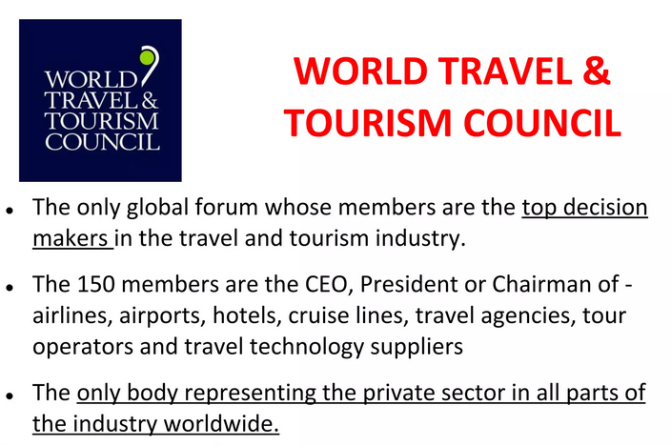

Slide 7
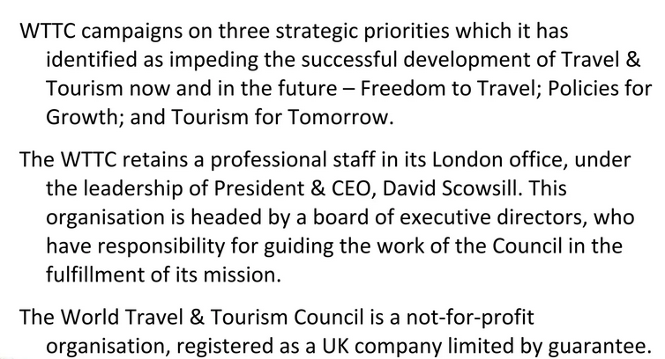

Slide 8


